Slide 1
Hierarchical Clustering

Slide 2
Introduction
A hierarchical method creates a hierarchical decomposition of the given set of data objects.
A hierarchical method can be classified as being either agglomerative or divisive
The agglomerative approach(bottom-up approach) starts with each object
forming a separate group. It successively merges the objects or groups that are close to one another, until all of the groups are merged into one (the topmost level of the hierarchy), or until a termination condition holds.
The divisive approach (the top-down approach) starts with all of the objects in the same cluster. In each successive iteration, a cluster is split up into smaller clusters, until eventually each object is in one cluster, or until a termination condition holds.

Slide 3
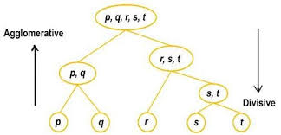
Example in general

Slide 4
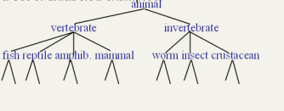
Example of animal kingdom

Slide 5
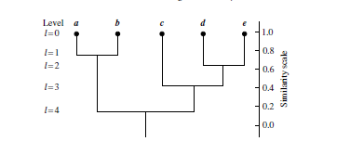
Dendograms
Dendograms are used to pictorially represent hierarchical clustering
It shows how objects are grouped together (in an agglomerative
method) or partitioned (in a divisive method) step-by-step.
L=0 shows the five objects
as singleton clusters at level 0. At l= 1, objects a and b are grouped together to form the first cluster, and they stay together at all subsequent levels.
Fig: Dendogram

Slide 6
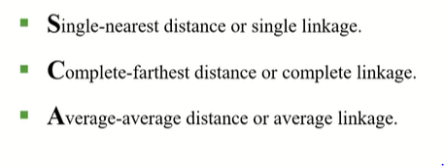
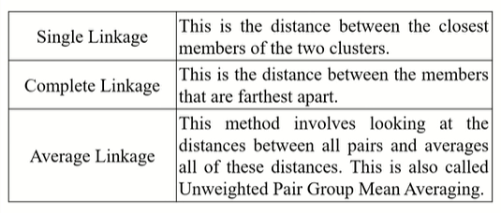
Hierarchical Agglomerative Clustering techniques

Slide 7
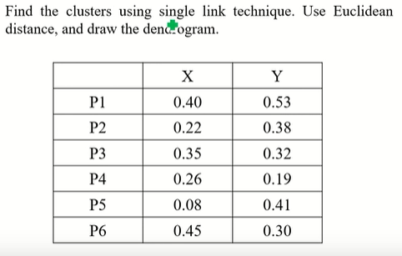
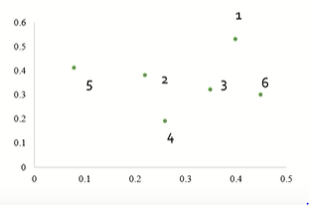
Example for single linkage cluster
Fig: Plot of the dataset

Slide 8
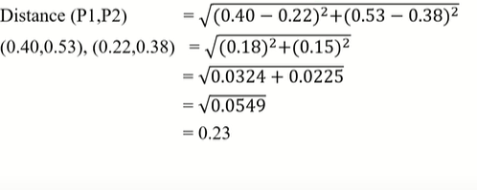
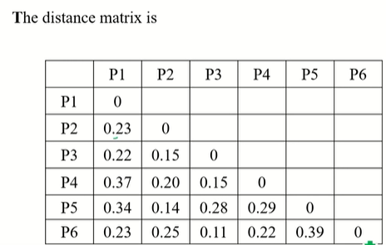
Find Euclidean distance between every pair of object.
Say,

Slide 9
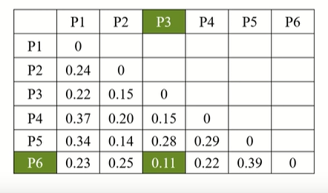
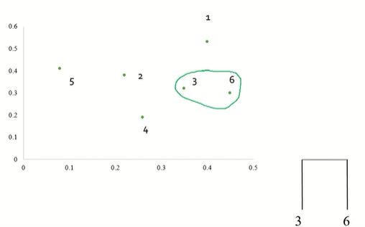
Find minimum distance in the distance matrix to form clusters
Plot looks like this -
Dendogram

Slide 10
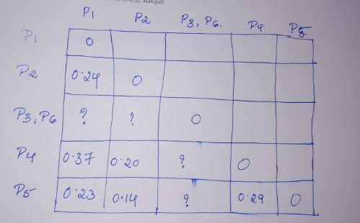
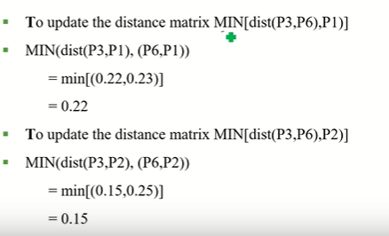
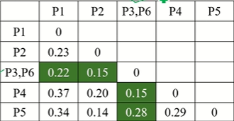

Slide 11
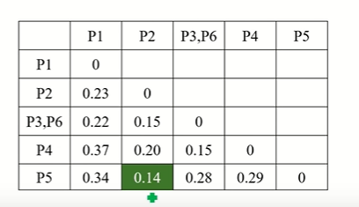
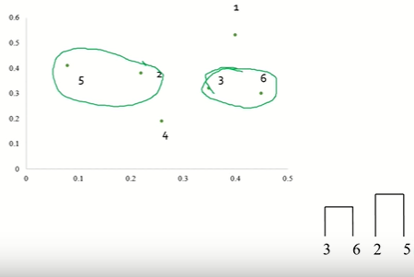
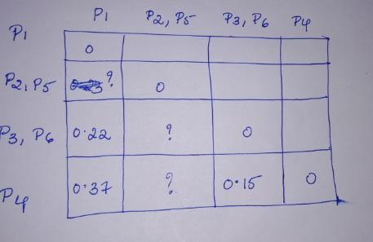
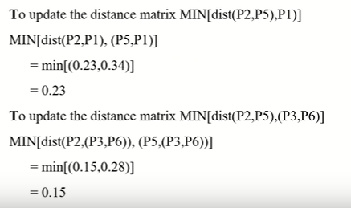
Find the next minimum distance
Plot looks like this -

Slide 12
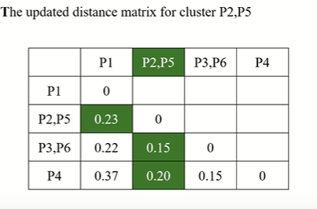
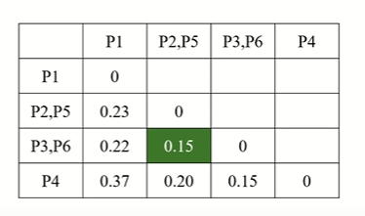
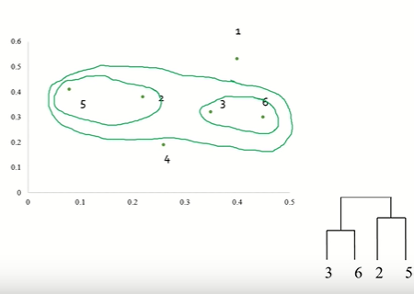
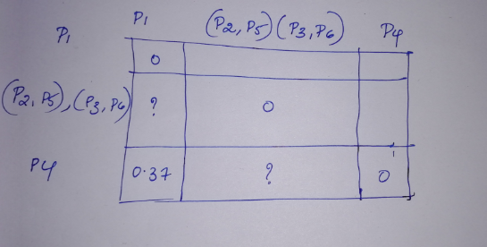
Finding the next minimum

Slide 13
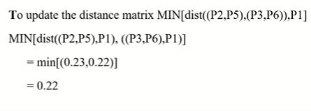
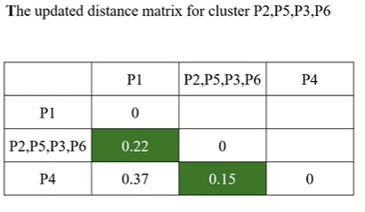
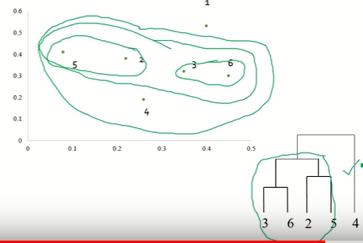
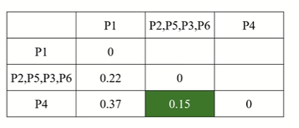
Finding out the minimum distance

Slide 14
